Slide 1
Engineering Solutions Using Nature’s Template
Andrew Fisher
Senior Electrical Engineering Major – COFSP Fellow
Northwest High School
Junior/Senior Anatomy and Physiology

Slide 2
Engineering Using Nature’s Template
Comparing the Human Eye to the Camera
“Students will be able to identify structures and functions of the human eye” (from NWSD Standards for A&P)
Creating a Human-Like Finger
“Students will be able to describe the functions of the human skeleton… muscle movements and provide examples”

Slide 3
Engineering Using Nature’s Template
Guiding Questions:
What are the components of an eye?
What are the components of a camera?
What do the human eye and the camera have in common?
What inventions have mimicked human anatomy?
How do engineers use the human form to influence their designs?
Learning Objectives
Students will be able to…
Identify the parts of a camera that correspond to the parts of a human eye
Trace the flow of light through a camera and how it is absorbed in the digital array
Name inventions that mimic the human form
Design and build model fingers from common craft items

Slide 4
Engineering Using Nature’s Template
Engineering Design Process
EDP not used in its entirety
Think → Design → Implement → Communicate
If the activity was one day longer, refinement could be added easily

Slide 5
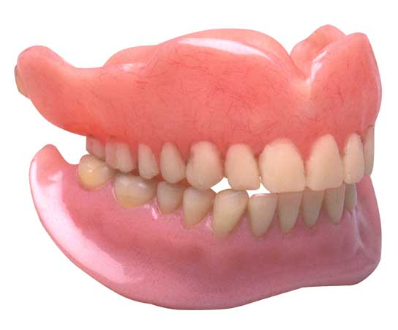
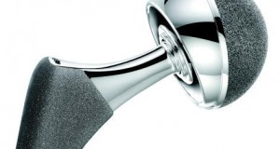
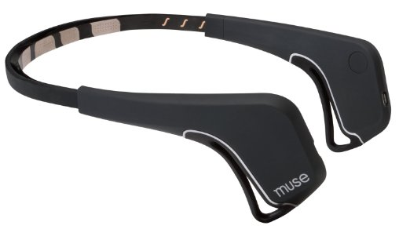
Engineering Using Nature’s Template
ACS
Many engineers depend on other sciences to influence their designs
Engineers are becoming more interested in human anatomy
Engineers can use knowledge on nature to create “greener” solutions

Slide 6
Student Growth

Slide 7
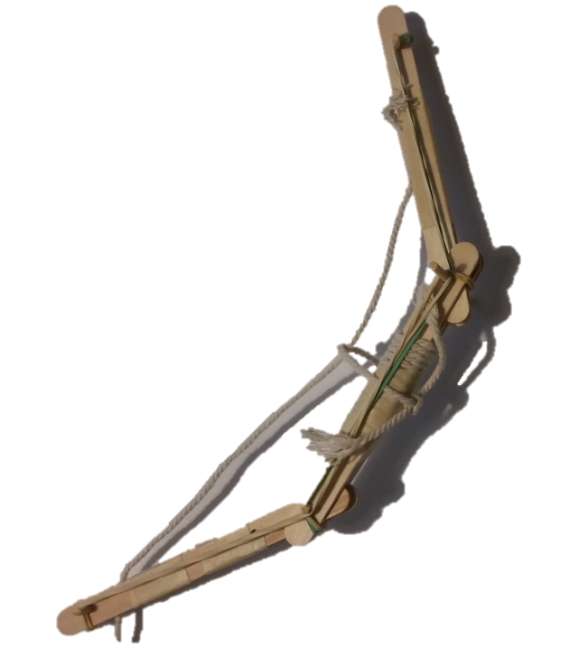
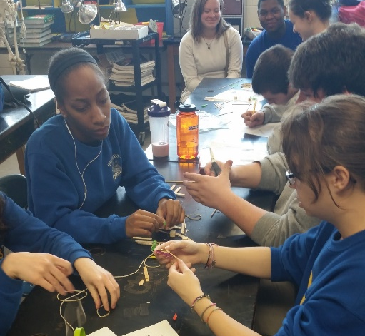
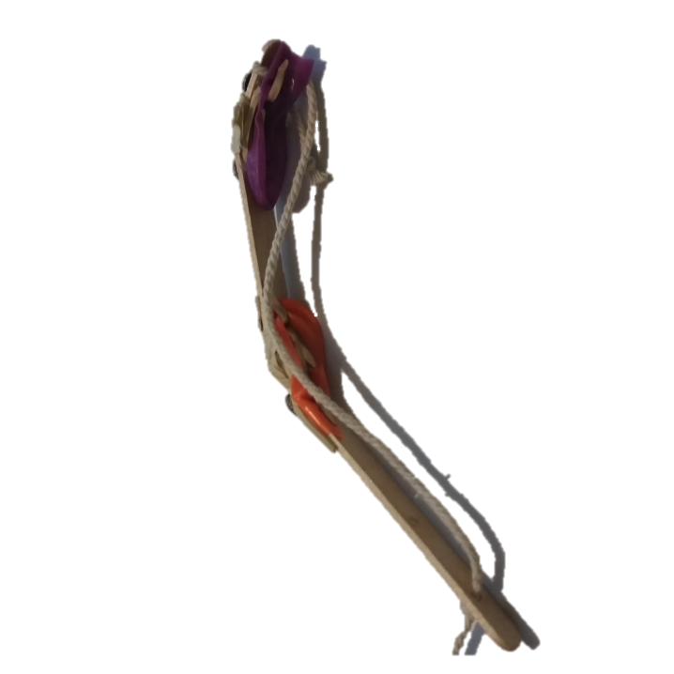
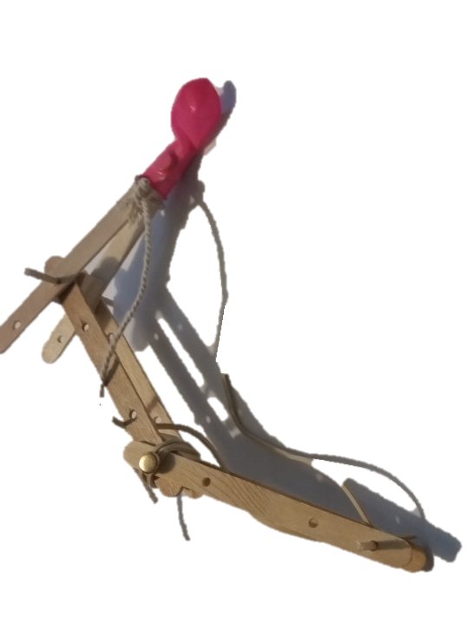
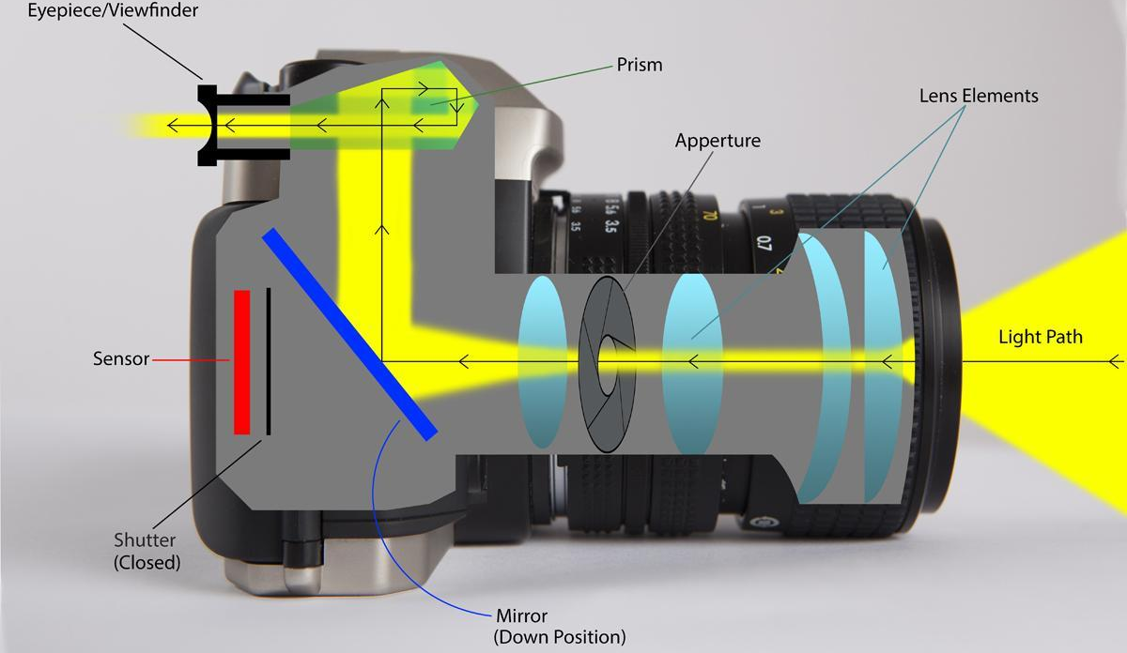
Student Engagement

Slide 8
Engineering Using Nature’s Template
Activity Reflections
What made this activity successful
Students prior knowledge of the eye
Small class size
High student participation
What can be improved
Students having a small background in anything electrical
Refinement stage when completing the finger activity
More time with finger activity could yield a full gripper (or “hand”)

